Slide 1
Analysis Of Food and Beverage Industry Survey Data
NAME- ABHIJEET KUNDU
MENTORNESS
Batch – MIP-DA-13

Slide 2
INTRODUCTION
This Power BI project aims to analyze survey responses from the food and beverage
industry to gain valuable insights into consumer behavior, preferences, and perceptions.
By understanding consumer choices, the analysis will help identify trends, assess brand
perception, and explore areas for improvement in product offerings and marketing
strategies.
Why This Analysis is Important: The food and beverage industry is highly competitive, and understanding what drives
consumer behavior is crucial for improving products, meeting consumer expectations,
and staying ahead in the market. This analysis will provide key
insights into factors such as health concerns, preferences for natural products, and
packaging preferences, all of which are essential for optimizing business strategies.

Slide 3
Data Description Fact Table: fact_survey_responses • Response_ID: Unique identifier for each survey response. • Respondent_ID: Unique identifier for each respondent. • Consume_frequency: Frequency of consumption of food and beverage products. • Consume_time: Typical time when the products are consumed. • Consume_reason: Reasonsfor consuming the products. • Heard_before: Whether the respondent has heard of the product before. • Brand_perception: Respondent's perception of the brand. • General_perception: Overall perception of the food and beverage industry. • Tried_before: Whether the respondent has tried the product before. • Taste_experience: Respondent's experience with the taste of the product. • Reasons_preventing_trying: Reasons preventing respondentsfrom trying the product. • Current_brands: Brands currently consumed by the respondent. • Reasons_for_choosing_brands: Reasonsfor choosing specific brands. • Improvements_desired: Improvements desired in products. • Ingredients_expected: Expected ingredients in products. • Health_concerns: Health concernsrelated to products. • Interest_in_natural_or_organic: Interest in natural or organic products. • Marketing_channels: Preferred marketing channels for product information. • Packaging_preference: Preferencesfor product packaging. • Limited_edition_packaging: Interest in limited edition packaging. • Price_range: Preferred price range for products. • Purchase_location: Typical locations where products are purchased. • Typical_consumption_situations: Common situationsin which products are consumed. Dimension Table: dim_respondent • Respondent_ID: Unique identifier for each respondent. • Name: Name of the respondent. • Age: Age of the respondent. • Gender: Gender of the respondent. • City_ID: Identifier linking the respondent to a city. Dimension Table: dim_cities • City_ID: Unique identifier for each city. • City: Name of the city. • Tier: Tier classification of the city (e.g., Tier 1, Tier 2).

Slide 4
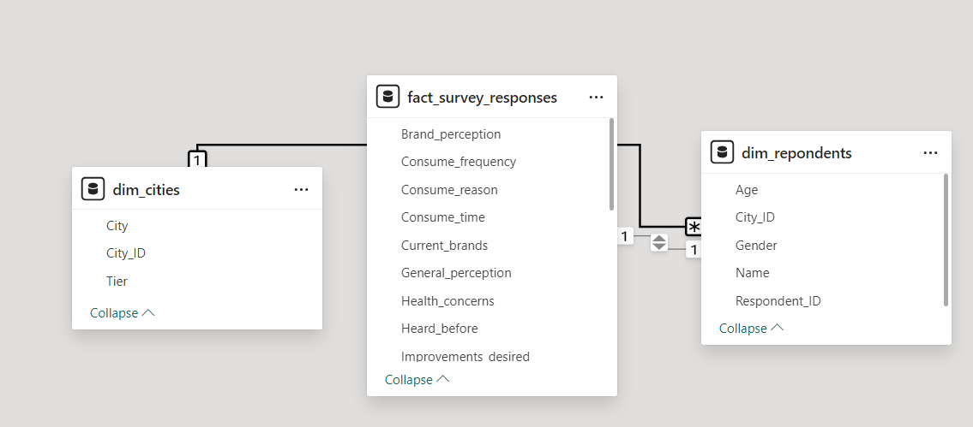
MODEL VIEW-

Slide 5
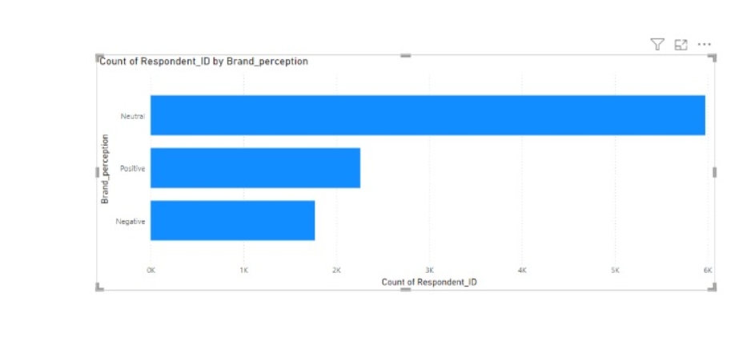
DATA OVERVIEW-

Slide 6
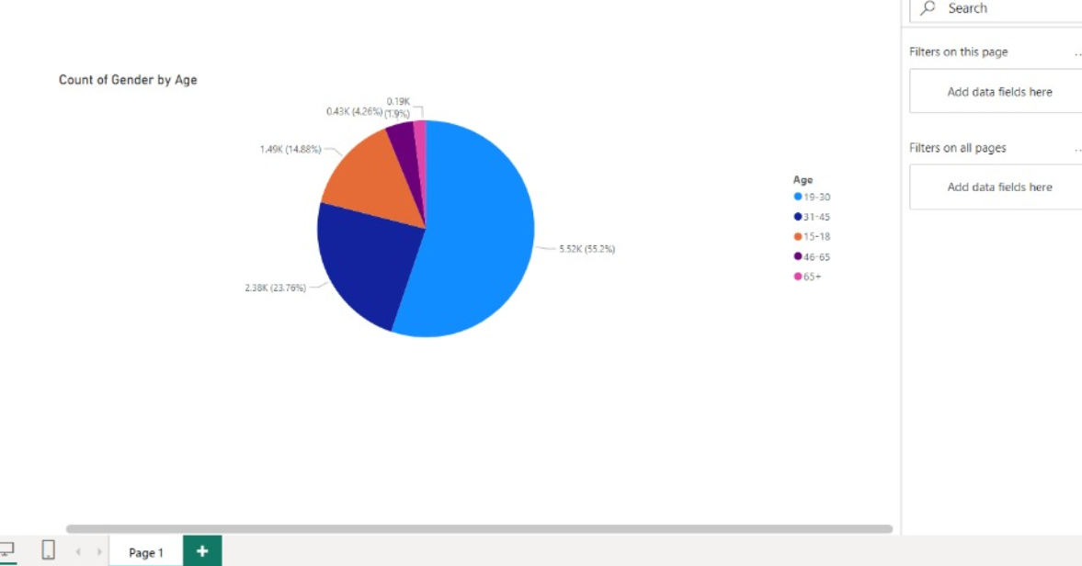
Count of Gender by age

Slide 7
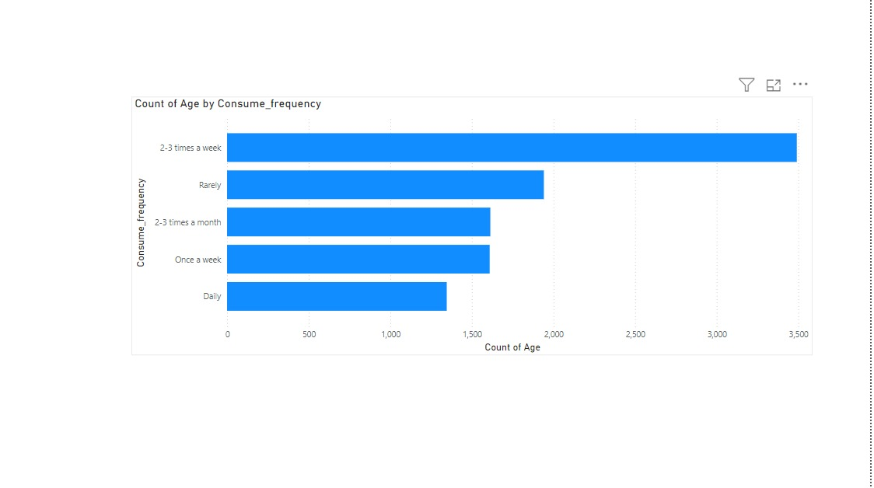
Count of age by consumer_frequency

Slide 8
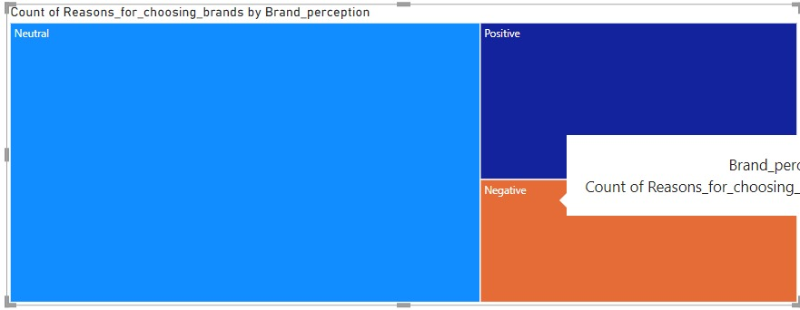
Count of reasons for choosing brands

Slide 9
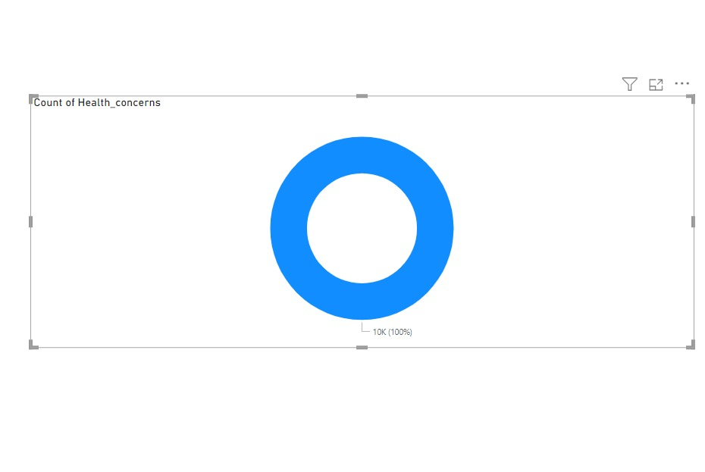
Count of Health Concerns

Slide 10
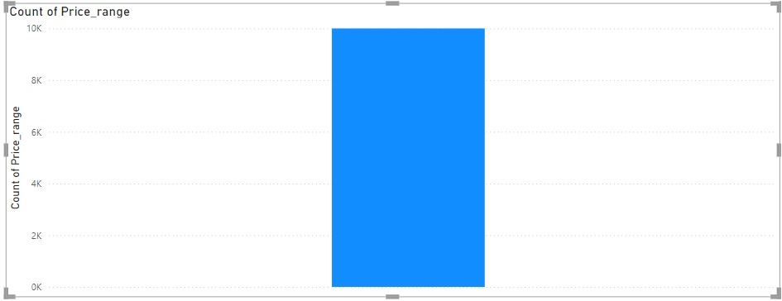
Count of Price_range

Slide 11
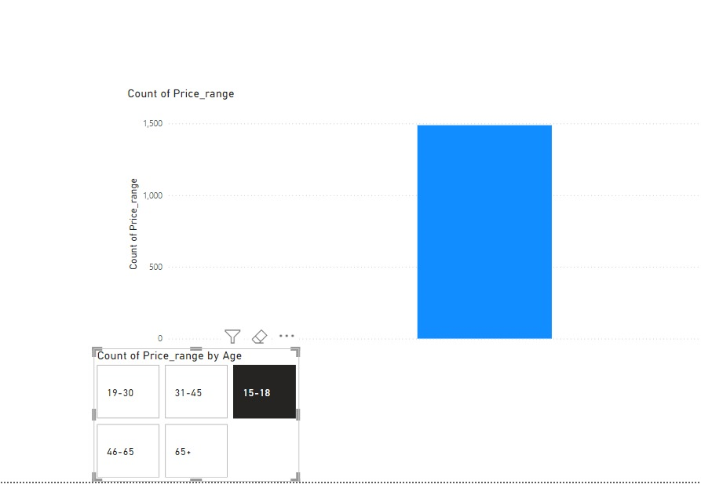
Count of Price_range by age

Slide 12
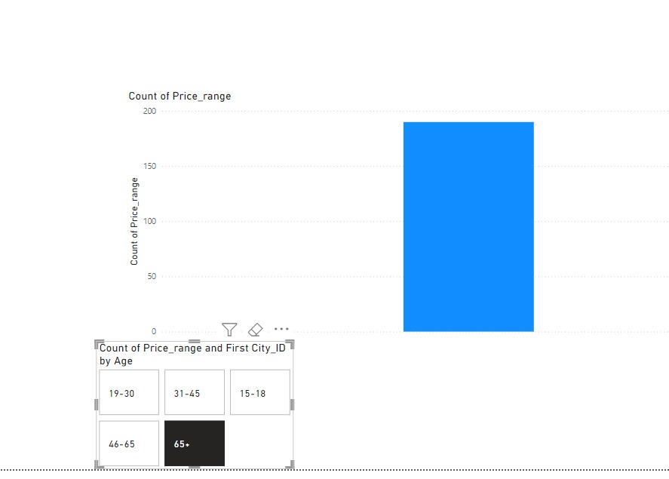
Count of Price_range and first city_id by age

Slide 13
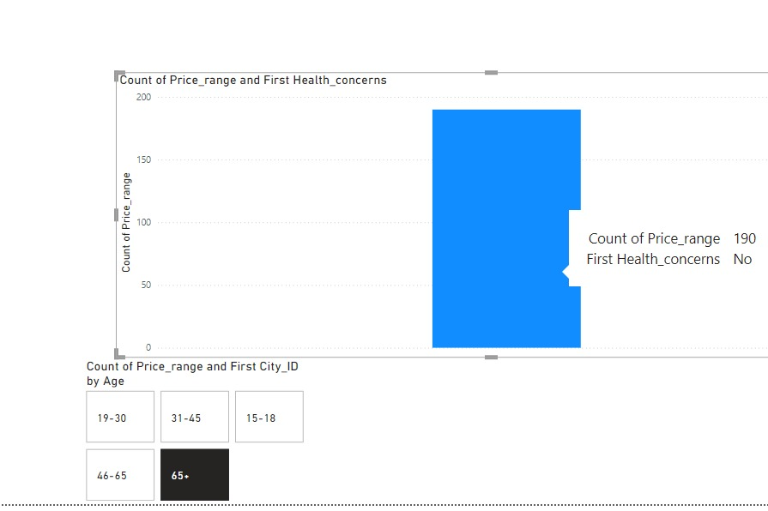
Count of Price_range and First Health_concerns

Slide 14
Conclusion
Summary of Key Findings:
Consumer Preferences: A significant portion of respondents prioritize product quality, taste, and health-related factors when choosing food and beverage products.
Health Concerns: Many consumers express concerns related to sugar content, additives, and other health risks. There is also a growing interest in natural and organic products.
Brand Perception: Consumers tend to favor brands they perceive as trustworthy and offering healthier options, with a notable preference for brands that provide clear and transparent ingredient information.
Marketing and Packaging: Digital marketing channels, particularly social media, are preferred by younger consumers, while packaging design and sustainability are also highly valued.

Slide 15
THANK YOU

